Slide 1
Automated Hyperspectral Pyrometry of Floating Zone Growths
Naman Parikh¹, David Elbert², Tyrel McQueen³
¹Department of Physics, Carnegie Mellon University
²Hopkins Extreme Materials Institute
³Department of Chemistry, Johns Hopkins University
Notes:
I’m going to talk about pyrometry for floating zone growths, specifically measuring temperature distributions. But first, I want to give some motivation for why we want to do this, which has to do with the idea of digital twins.

Slide 2
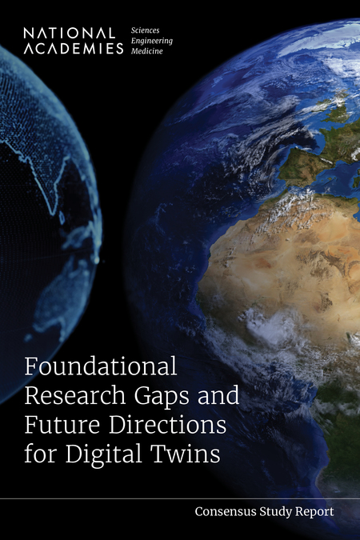
Digital Twins
“Set of virtual information constructs that mimics the … system”
“Has a predictive capability”
“Dynamically updated with data from it’s physical twin”
National Academies of Sciences, Engineering, and Medicine
https://doi.org/10.17226/26894
Notes:
A digital twin is a set of virtual information constructs that mimics a physical system. The exact form can vary, but generally we’re talking about some kind of computational model or simulation. A very familiar property of a digital twin is that it has some capability to make predictions about the physical system given some inputs. The connection should go both ways, so the digital model should be informed by and able to update its predictions using data from it’s physical twin. This is a two way connection, or bidirectional interaction as the report calls it.

Slide 3
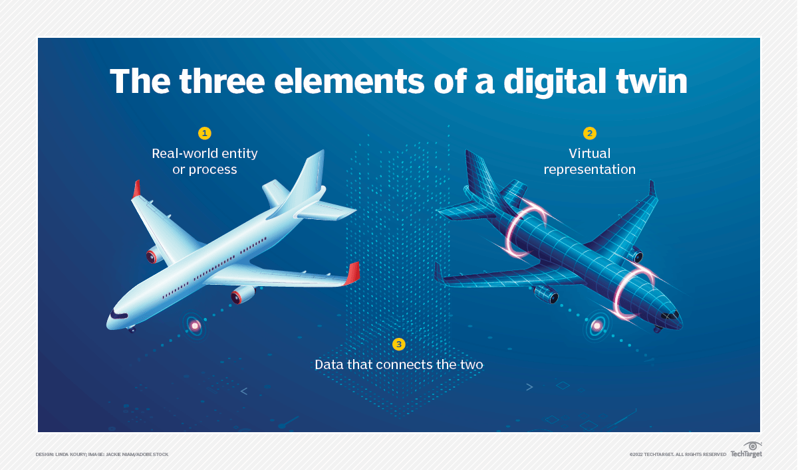
Scott S. Dossa, Jeffrey J. Derby
https://doi.org/10.1016/j.jcrysgro.2022.126723
Notes:
So, if we’re ultimately interested in developing a digital twin for floating zone growths, we need to identify the main elements that go into it. There’s the physical system and the digital representation of it, and there’s also the very important piece that’s the data that connects the two twins. Like the bidirectional interaction, data from the physical informs the digital, and the digital generates similarly structured data that predicts the physical.

Slide 4
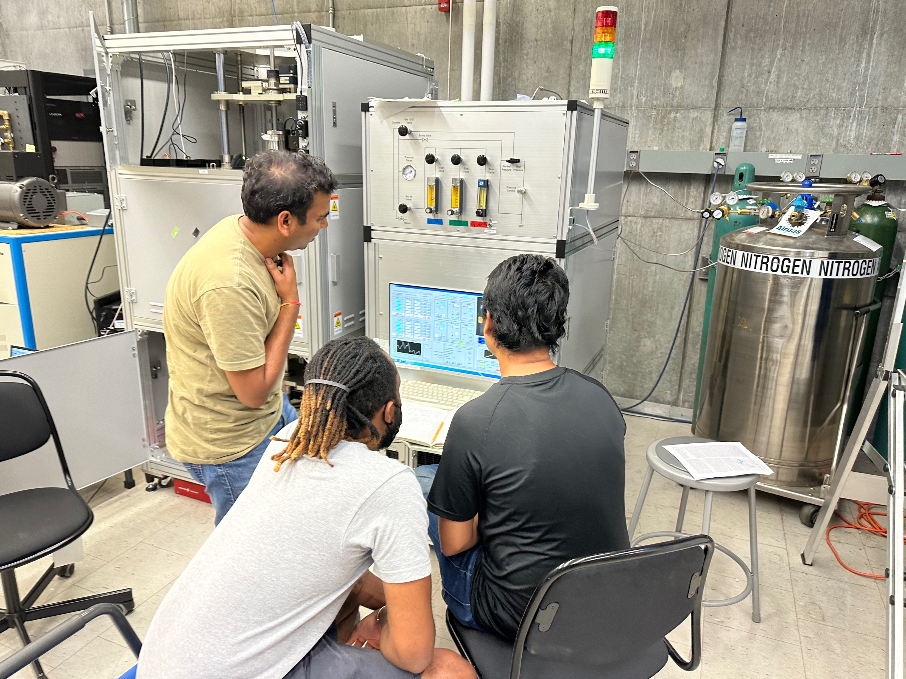
Laser Diode Floating Zone
Notes:
The physical system that we used this summer was a Laser Diode Floating Zone furnace.

Slide 5
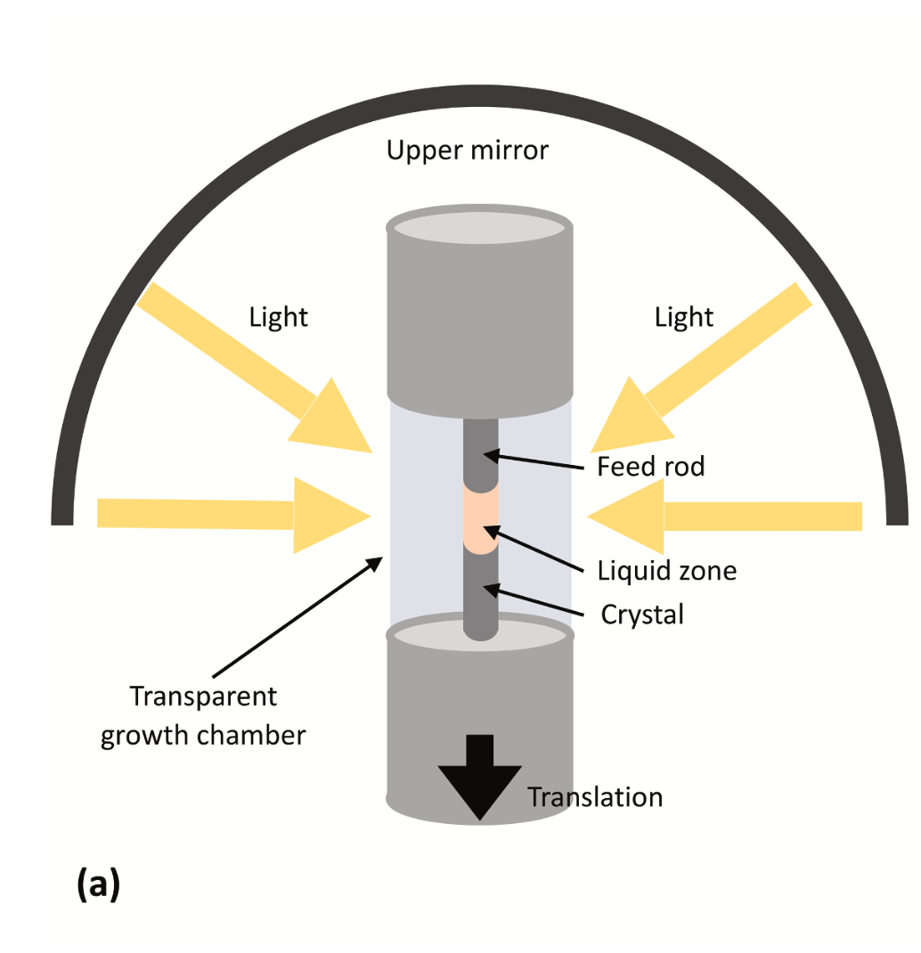
Scott S. Dossa, Jeffrey J. Derby
https://doi.org/10.1016/j.jcrysgro.2022.126723
Notes:
To briefly overview the main parts of a floating zone growth, we have two rods of materials: a crystal solid below and a feed rod above. The ends of the rods are melted by intense light and then joined to form the liquid zone from which the crystal grows

Slide 6
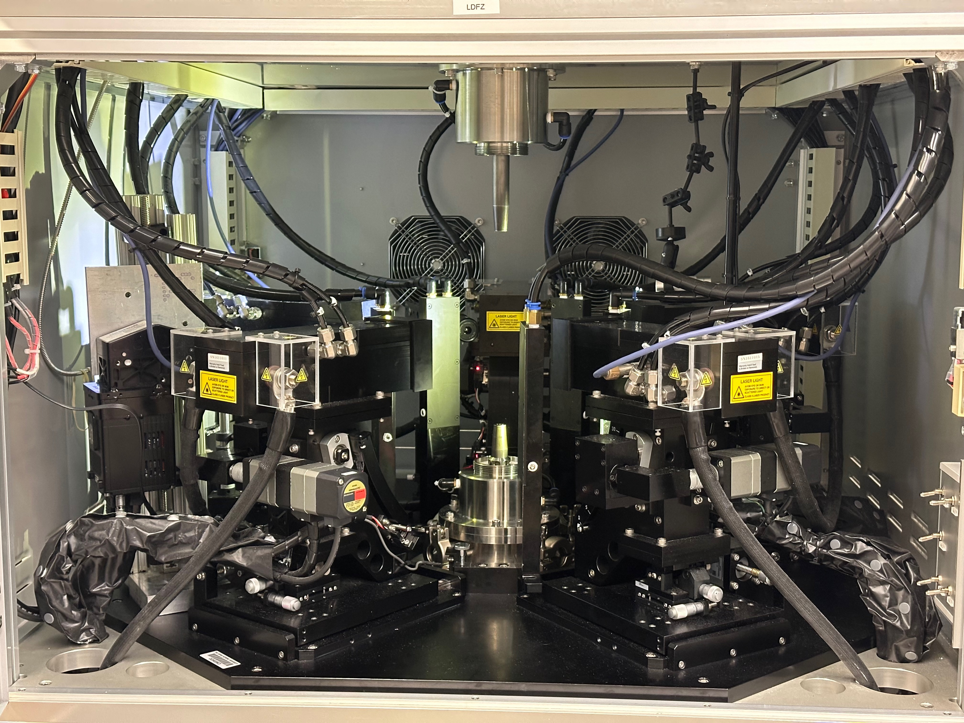
Notes:
This is the chamber of the Laser Diode furnace with 5 high-powered lasers.

Slide 7
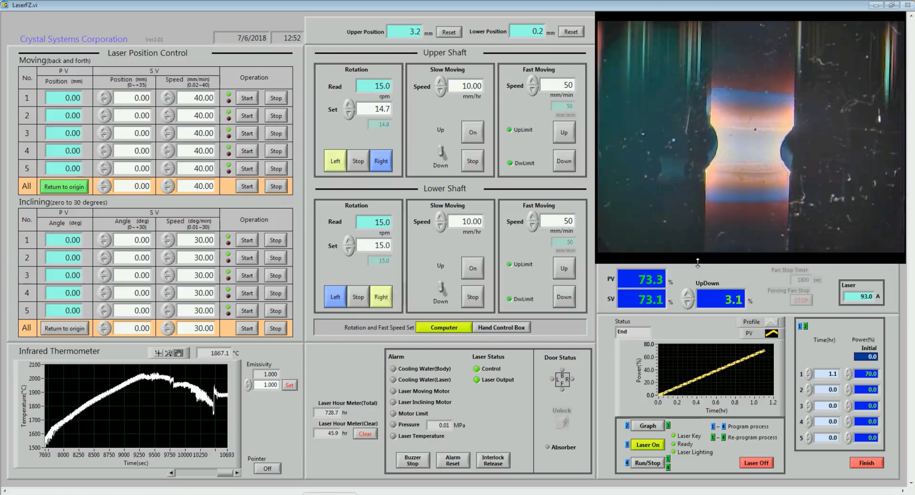
Notes:
Alongside the growth, there’s also the physical controls that the furnace has. This includes the movement of the rods and the heating power

Slide 8
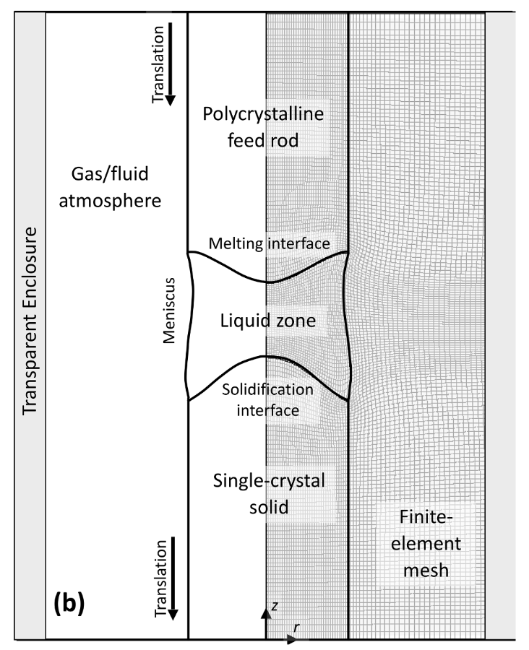
Scott S. Dossa, Jeffrey J. Derby
https://doi.org/10.1016/j.jcrysgro.2022.126723
Notes:
On the digital side, there has been work from Dossa and Derby on modelling floating zone growths. These models put a finite-element mesh on the growth and its surroundings …

Slide 9
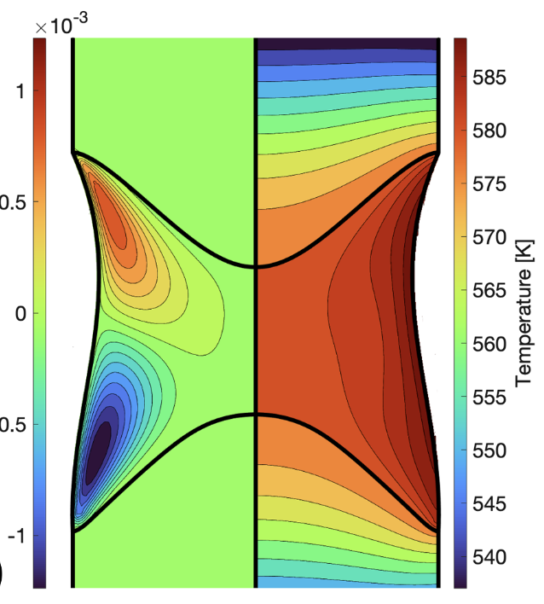
Scott S. Dossa, Jeffrey J. Derby
https://doi.org/10.1016/j.jcrysgro.2022.126723
Notes:
... and evaluate the temperature distribution. The temperature distribution in the molten zone is a critical parameter in the physics of the crystal growth and affects the resulting crystal structure and properties, and so it would be great data to connect the physical growths and digital models.

Slide 10
How can we collect temperature distributions across the molten zone?
Notes:
So, the research question I attacked this summer was “How can we collect data about temperature distributions across the molten zone?”

Slide 11
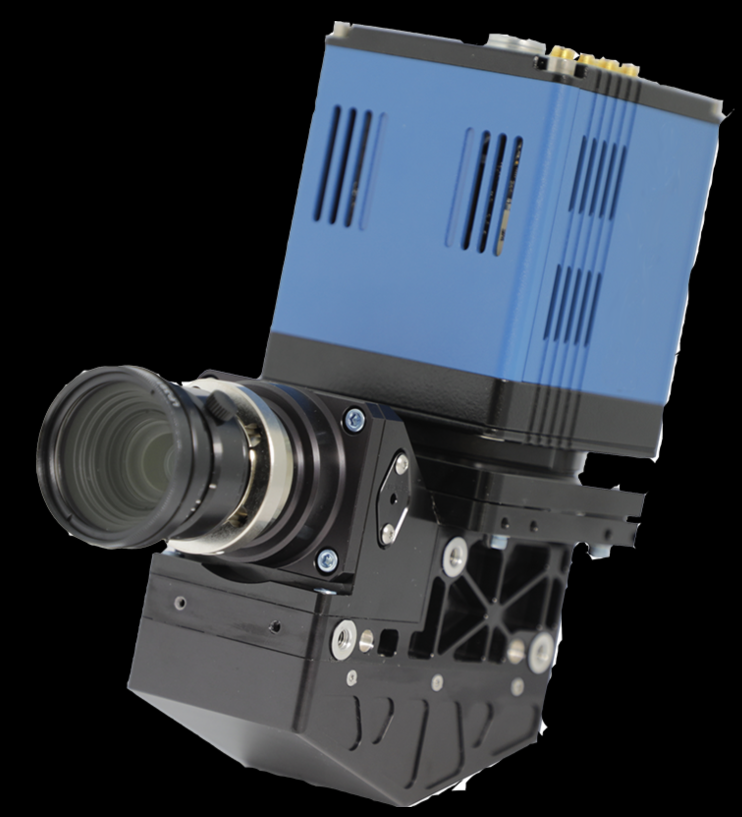
Hyperspectral Camera
Notes:
To do this, we made use of a hyperspectral camera that we mounted in the furnace. Hyperspectral imaging captures a detailed spectrum for each pixel. This particular camera gets over 300 wavelengths.

Slide 12
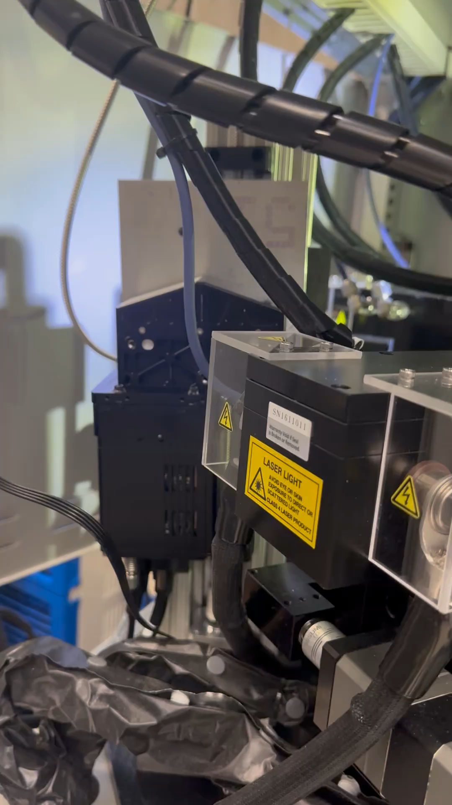
Collect hyperspectral data from the molten zone
Process hyperspectral images into temperature distributions
Create a streaming process for real-time data
Notes:
So, what did I do? First thing is collecting this hyperspectral data from the molten zone. To do that we got the camera mounted in the furnace and moving. The camera has to move because it sees a line rather than a full two dimensional image, so it needs to scan up and down across the molten zone.
Secondly, we need to figure out how to process hyperspectral images and turn them into temperature distributions, which is the data that we are ultimately after.
Finally, we want to create a streaming process for the collection and analysis so that we can get results back in real time.

Slide 13
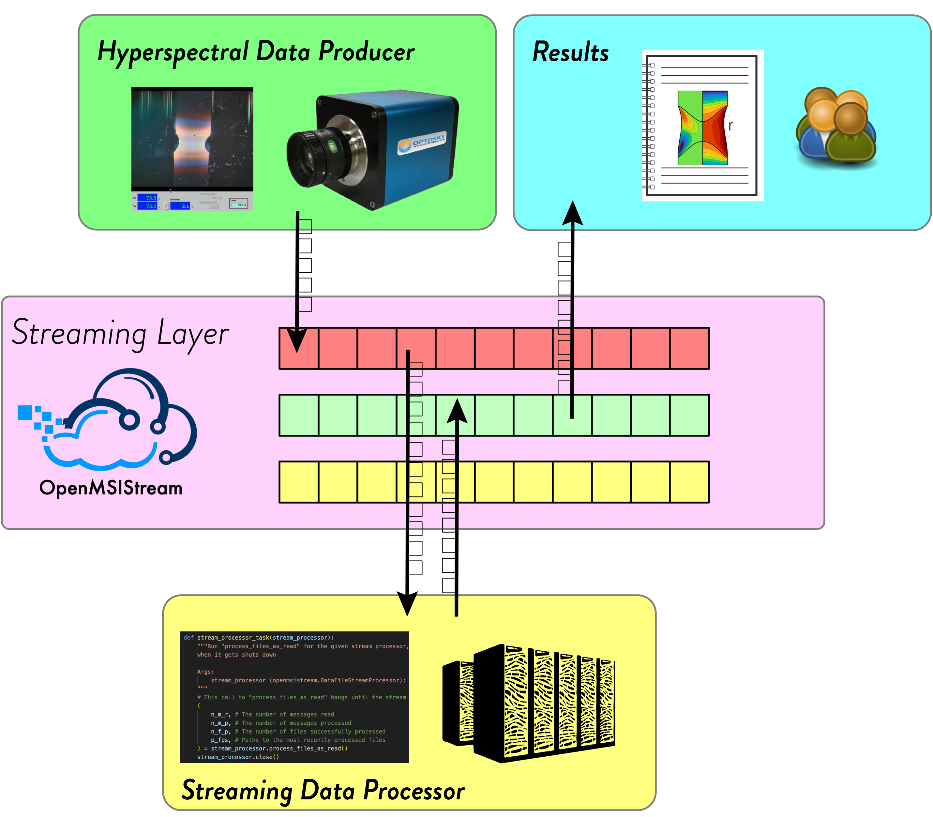
Notes:
We use something called data streaming. When the image is captured by the camera, it is automatically streamed out to a server. From there, the data is consumed by a stream processor that’s hosted on one of our paradim servers. There, the raw data is both stored in a database and also analyzed. The resulting temperature distribution is then streamed back out to the third party and then back to the lab so that the people doing the growth can see the results in real time.
Now that everything is set up, we can put the camera in the furnace and hit go, and things will pop out.

Slide 14
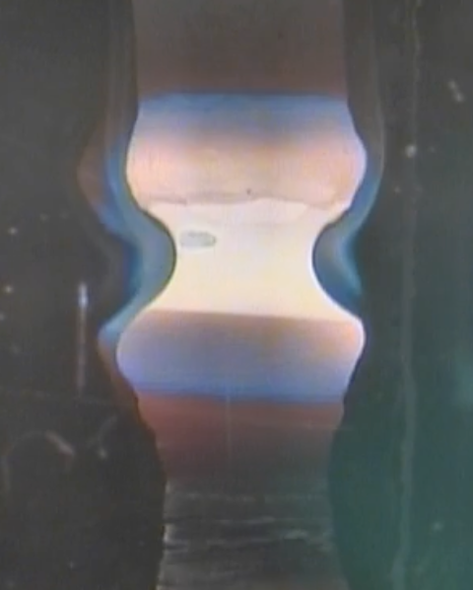
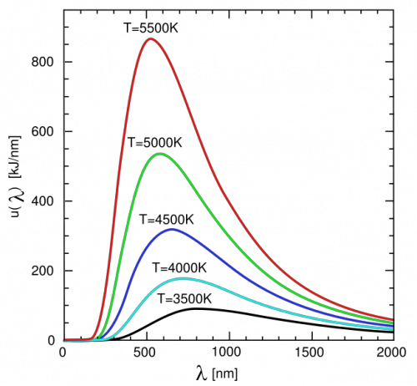
Pyrometry
Blackbody
Notes:
For the analysis we need to develop a pyrometry method to calculate temperature from a spectrum. The key observation for this is that the hot, glowing material in the growth is a blackbody, and as such is emitting a blackbody radiation spectrum. Blackbody spectra are completely unique depending on the temperature of the object, so in theory this contains all the information we need to get the temperature. One difficulty is that we don’t get to measure an entire spectrum because of the camera’s limited wavelength range, but as we’ll see this turns out to not be an issue.
To determine the temperature from the spectrum, we’ll use a standard least squares regression to fit the spectrum we measure for each pixel to a blackbody spectrum, and this will optimize temperature as a parameter for the fitting.

Slide 15
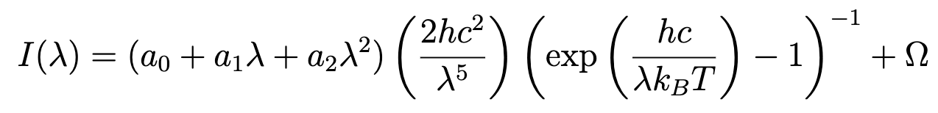
Blackbody Model Function
Emissivity
Stray Light Offset
Parameters
Notes:
To do the regression, the main thing we have to determine is what the equation that we’re fitting to is.
There’s 3 parts here. The middle is the actual core of the blackbody shape that should look familiar. The piece in front is an approximation of emissivity. Emissivity changes depending on the materials we use, so it needs to be a parameter in the equation. However, it can also vary over wavelength, so we use a quadratic expansion to model that dependence. Finally, there’s a constant offset at the end. This term improves the regression by adding some flexibility. Like any spectrum, blackbody radiation always goes to 0 as the wavelength goes to 0. However, forcing the fitting to stick to this turns out to cause some aggressive overfitting. The spectrum could be shifted up by stray light in the background or mistakes in correcting the spectrum against black and white references, so it helps to add this term to account for those things. With these added pieces, we have added parameters to optimize during the regression alongside temperature.

Slide 16
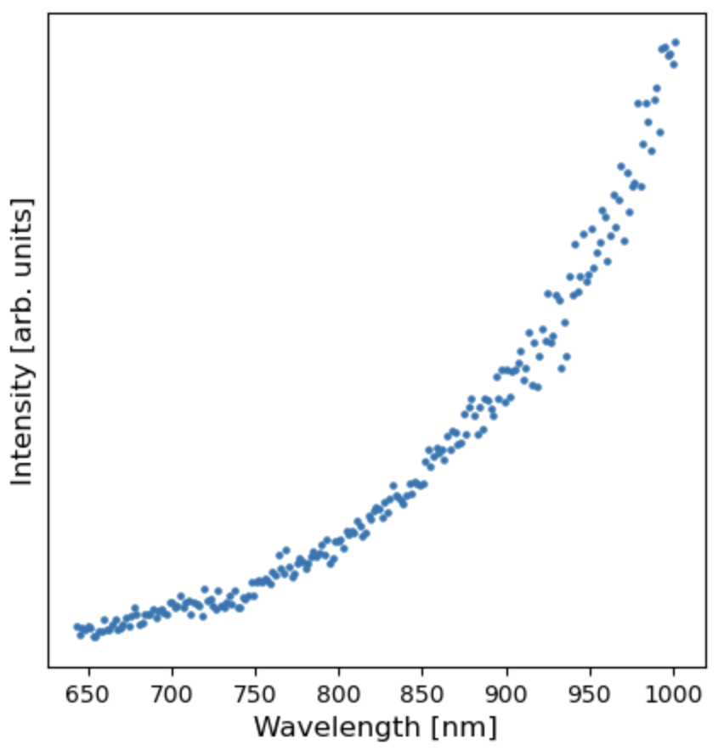
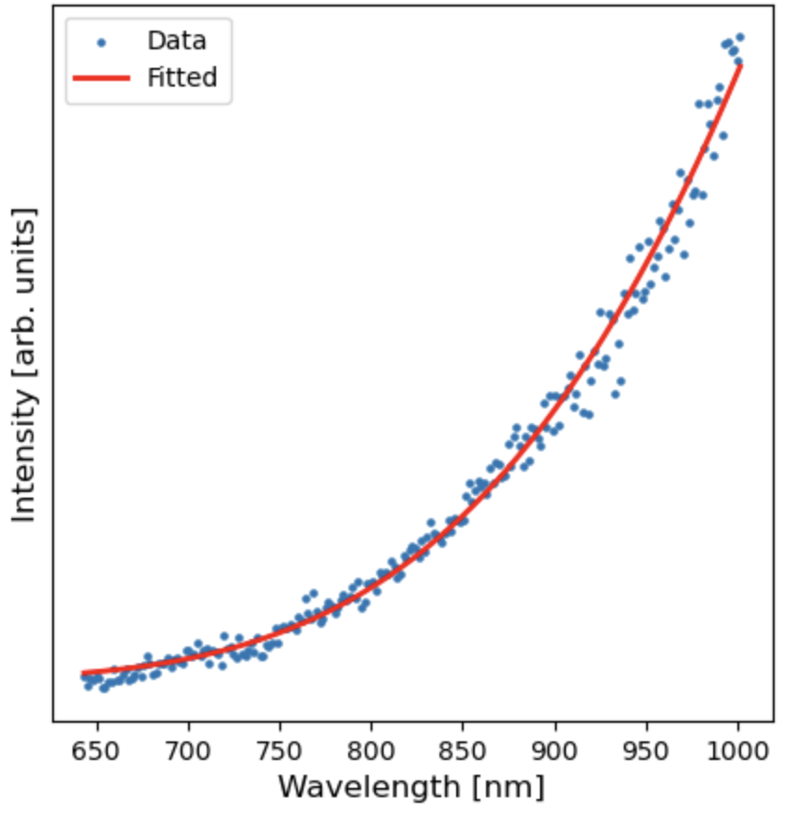
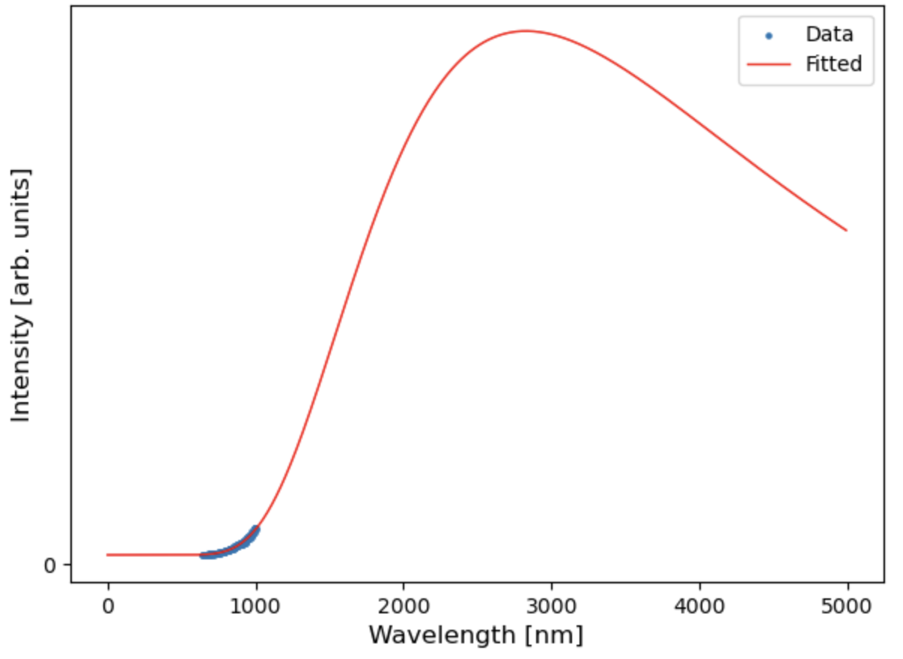
Data
Fitted with T=1298 K
Full Spectrum
Notes:
So, let’s take a look at how this works. Here’s a spectrum that we measured during testing. If we run the regression, we get a nice looking fit and a temperature value of about 1000 C. We can also zoom out to see that we actually have been looking at a very small part of the blackbody spectrum, but the regression is still successful.

Slide 17
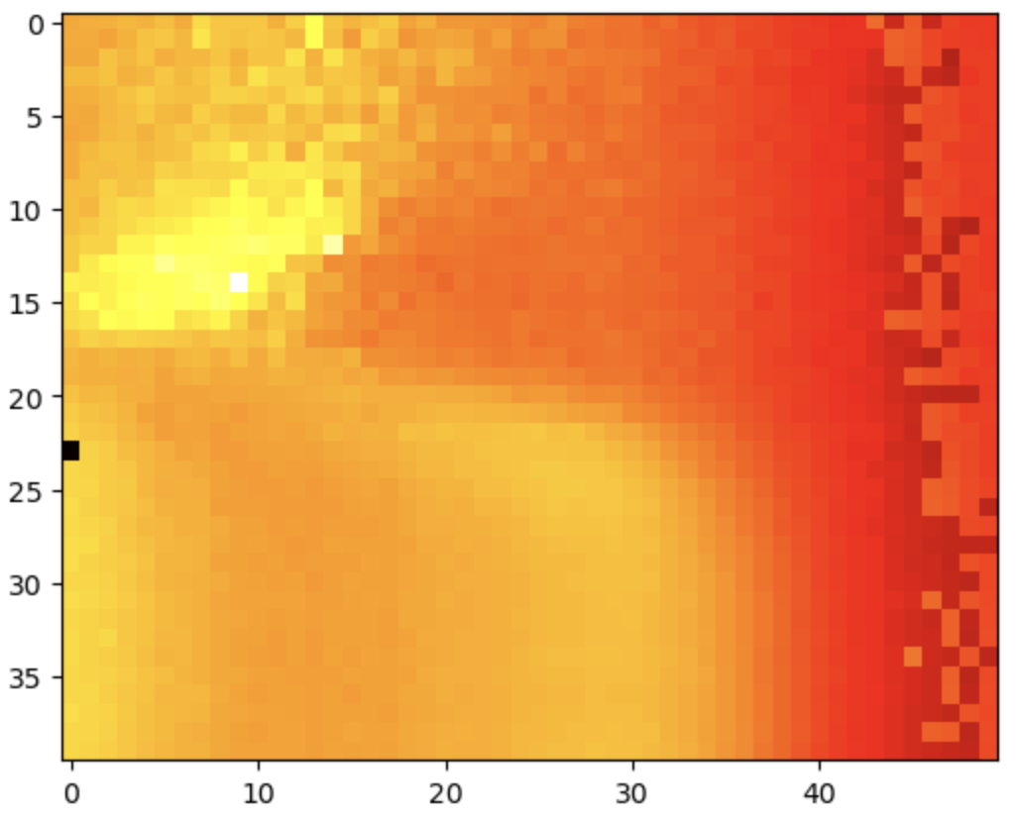
Notes:
This is an image I captured during a growth.

Slide 18
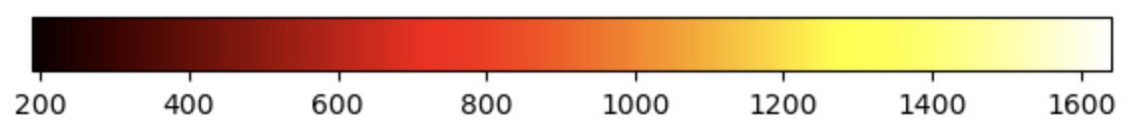
Kelvin

Slide 19
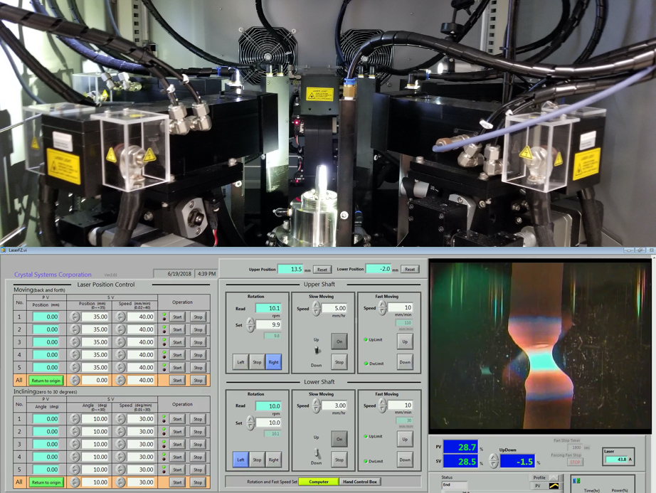
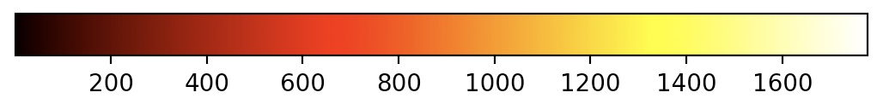
Physical
Data
Digital
Measurement
Predictions
Promising growths
Model validation and updating
Notes:
Finally, I want to take a step back and talk about how this fits into the bigger picture that I talked about at the beginning. This data is measured from physical experiments, and it can now be used to inform and validate the digital models that we talked about. Going the other way, we now speak a common data language so we can take the predictions the models dive and use them to inform future growths. Those growths in turn create more data, and the cycle of experimentation and improvement continues.

Slide 20
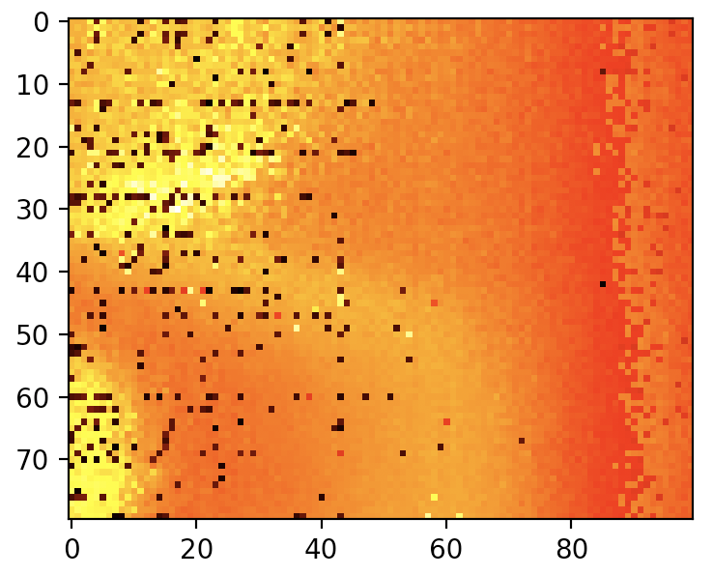
Acknowledgements
Physical
Digital
Data
Evan Crites (McQueen Lab, PARADIM)
Maggie Eminizer (IDIES)
NSF Awards #2039380 (PARADIM) and #2129051 (VariMat)

Slide 21
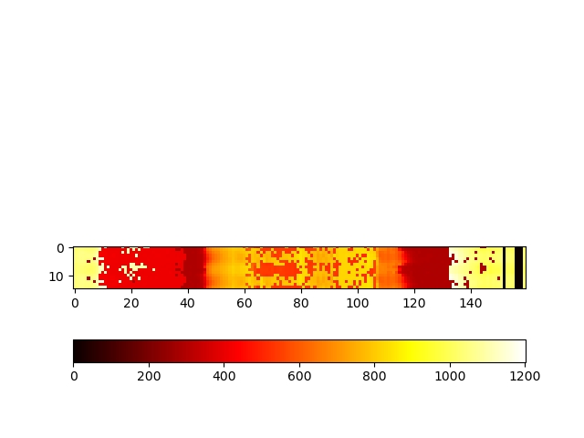
Into the furnace
Kelvin
21
Notes:
So, taking this analysis into the furnace, here we have an image from a growth. There’s not much to see in the png because this growth was too dark to see much. We can fix that by increasing the exposure time, but it turns out that we are still able to get temperature well with a low exposure, so I stuck with that. Also, because we set up all the automation, this is super easy to run. I clicked capture image, waited, and got back this heatmap. **Talk about what this is looking at, what we see**

Slide 22
Physical
Digital
Data
“Dynamically updated with data from it’s physical twin”
“Bidirectional interaction”
“Informs decisions that provide value”
Notes:
This hits on the last

Slide 23
Physical
Digital
Autonomous Experimentation
Data

Slide 24
Extra Slides – Full Resolution

Slide 25
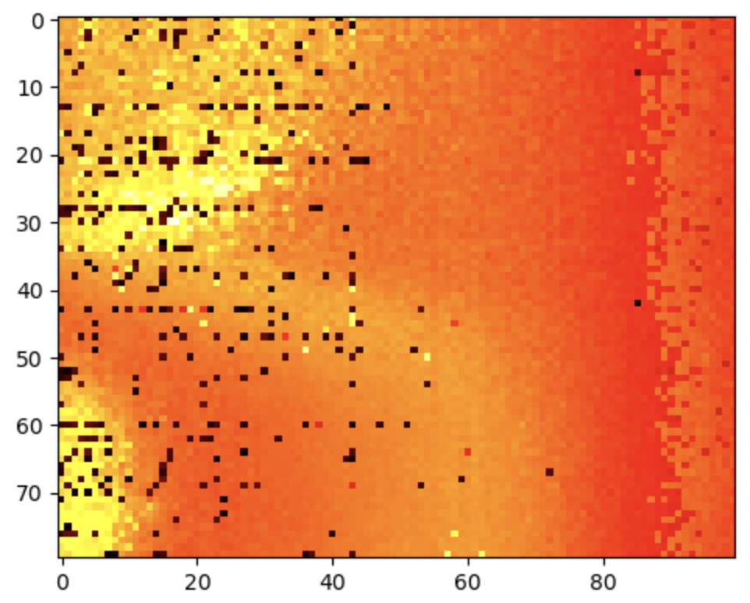

Slide 26
Extra Slides – Carbon Rod Fitting

Slide 27
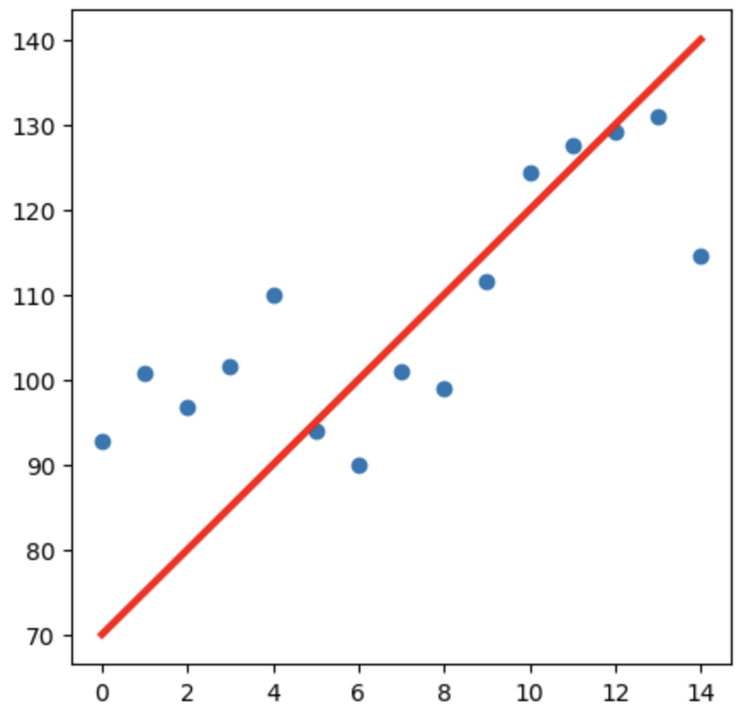
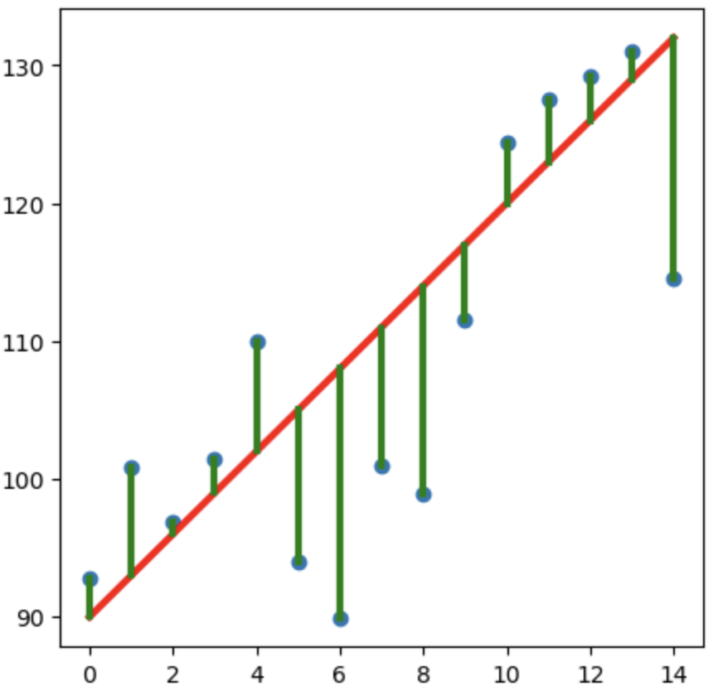
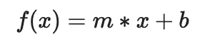
Least Squares Regression
Model Function
Guess Parameters
Minimize Residuals
Parameters
Notes:
To do this, we can use least squares regression. With this regression method, we start by providing a model function, which we know for blackbody radiation. The regression than optimizes parameters of the function, which will include temperature that we want. We then guess some parameters, getting a bad fit, but the residuals are minimized and parameters optimized to get the best fit. There’s lots of code already written to do the last part, so what we need to do for this specific usage is figure out what the model function should be.

Slide 28
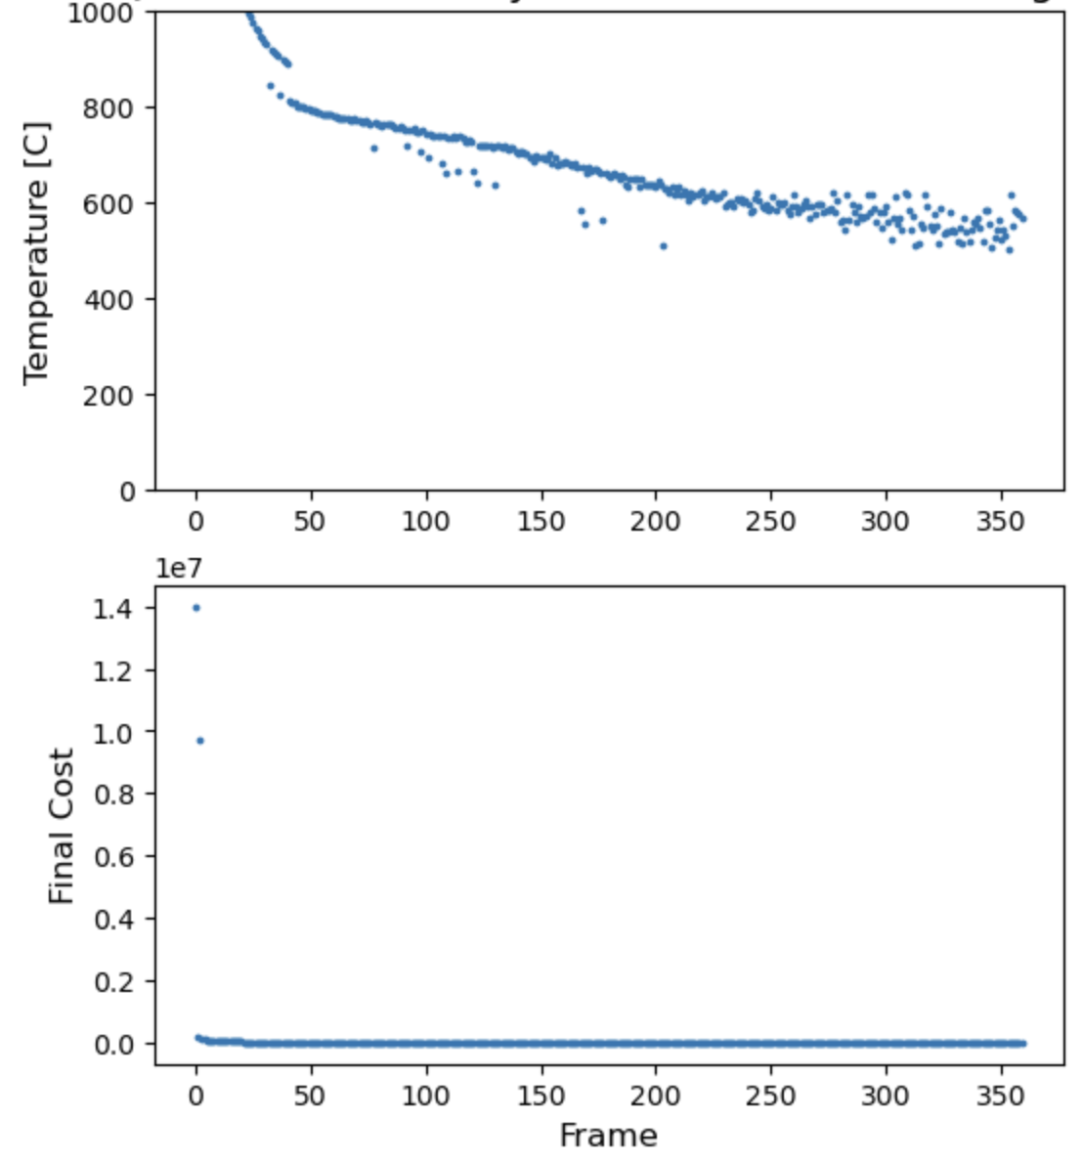
Notes:
This is some testing we did where we heated up a graphite rod to 1000

Slide 29
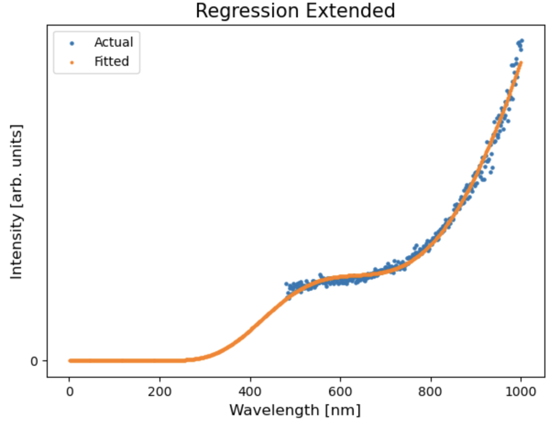
Overfitted
29

Slide 30
Extra Slides – Other Carbon Rod Spectra

Slide 31
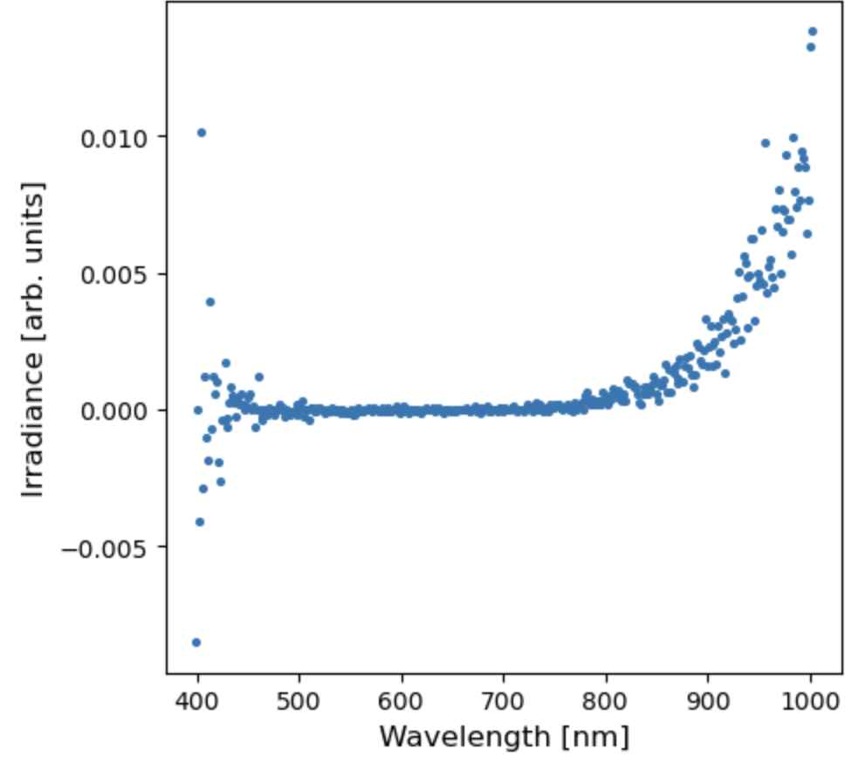
Carbon Rod Corrected

Slide 32
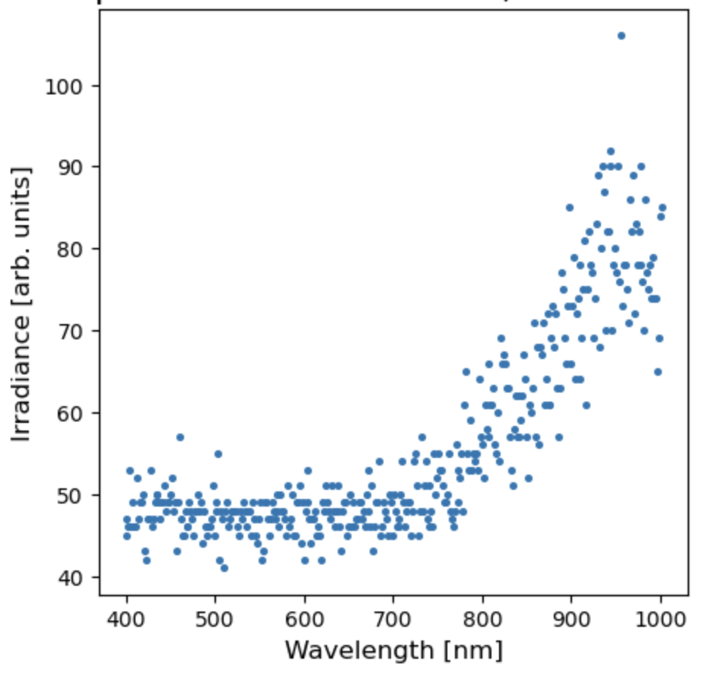
Carbon Rod Uncorrected

Slide 33
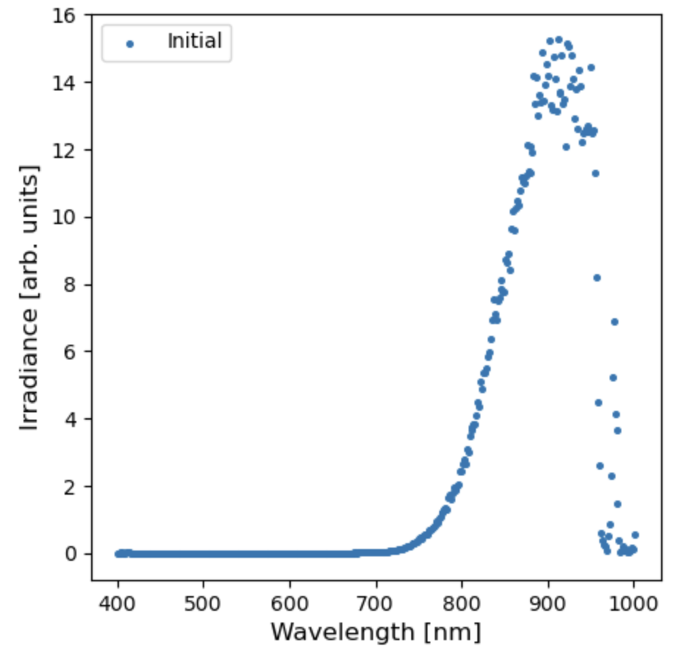
Notch Filter Dip

Slide 34
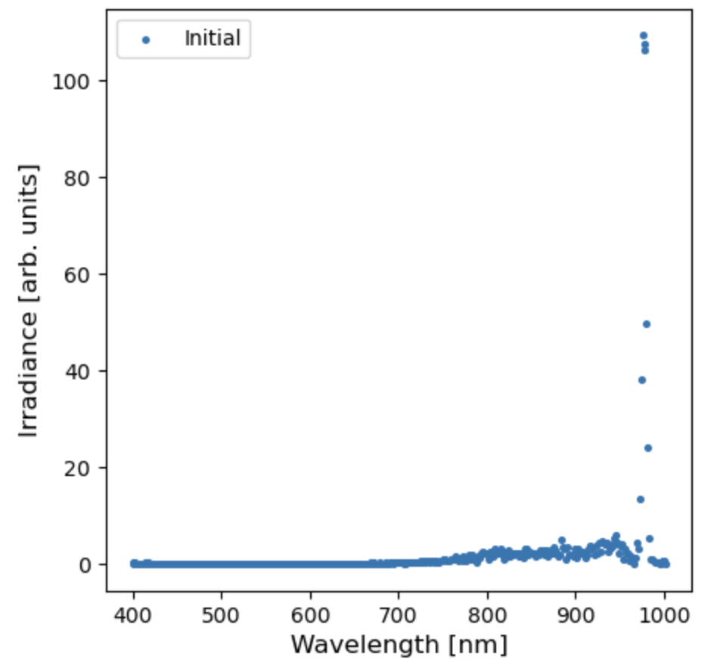
Laser Light Spike

Slide 35
Extra Slides – Camera Motion

Slide 36
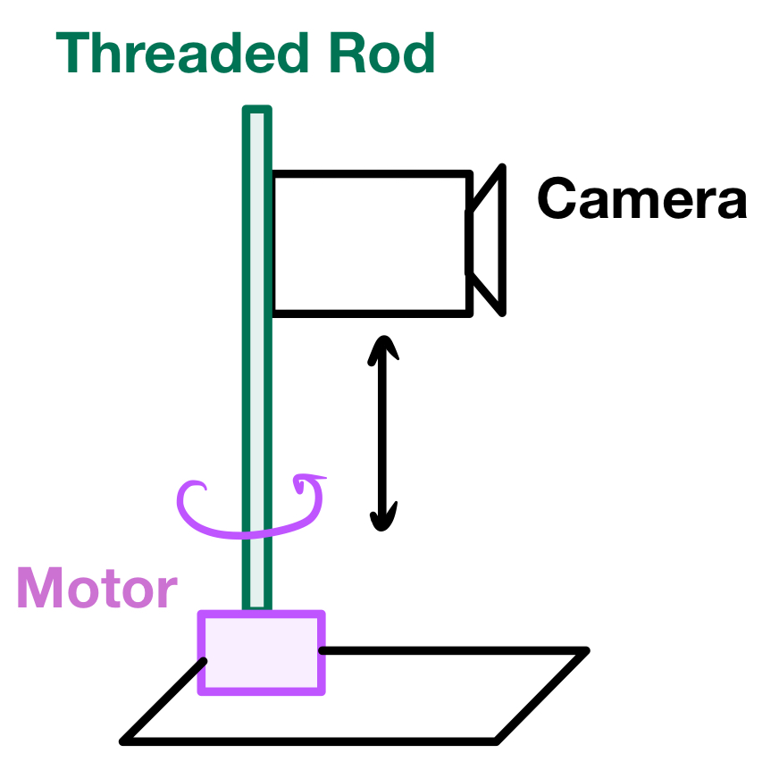
Notes:
How do we make it scan?

Slide 37
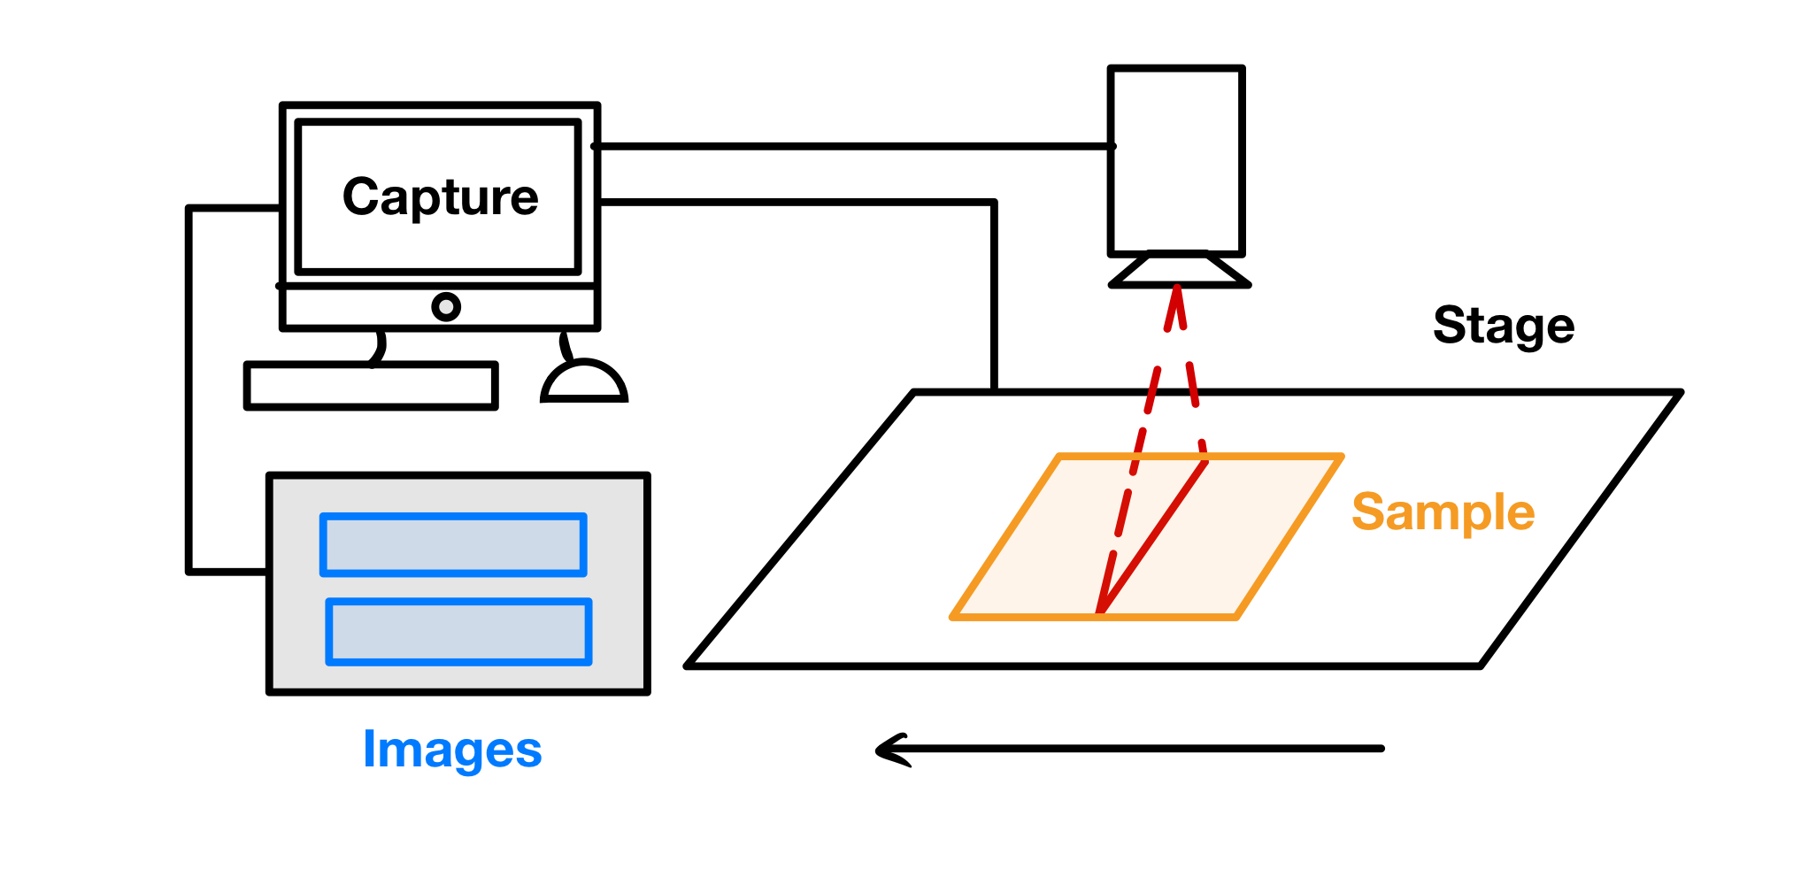
Notes:
Why does it need to move?
Important to note that the computer syncs the start of the image capture and the movement of the stage

Slide 38
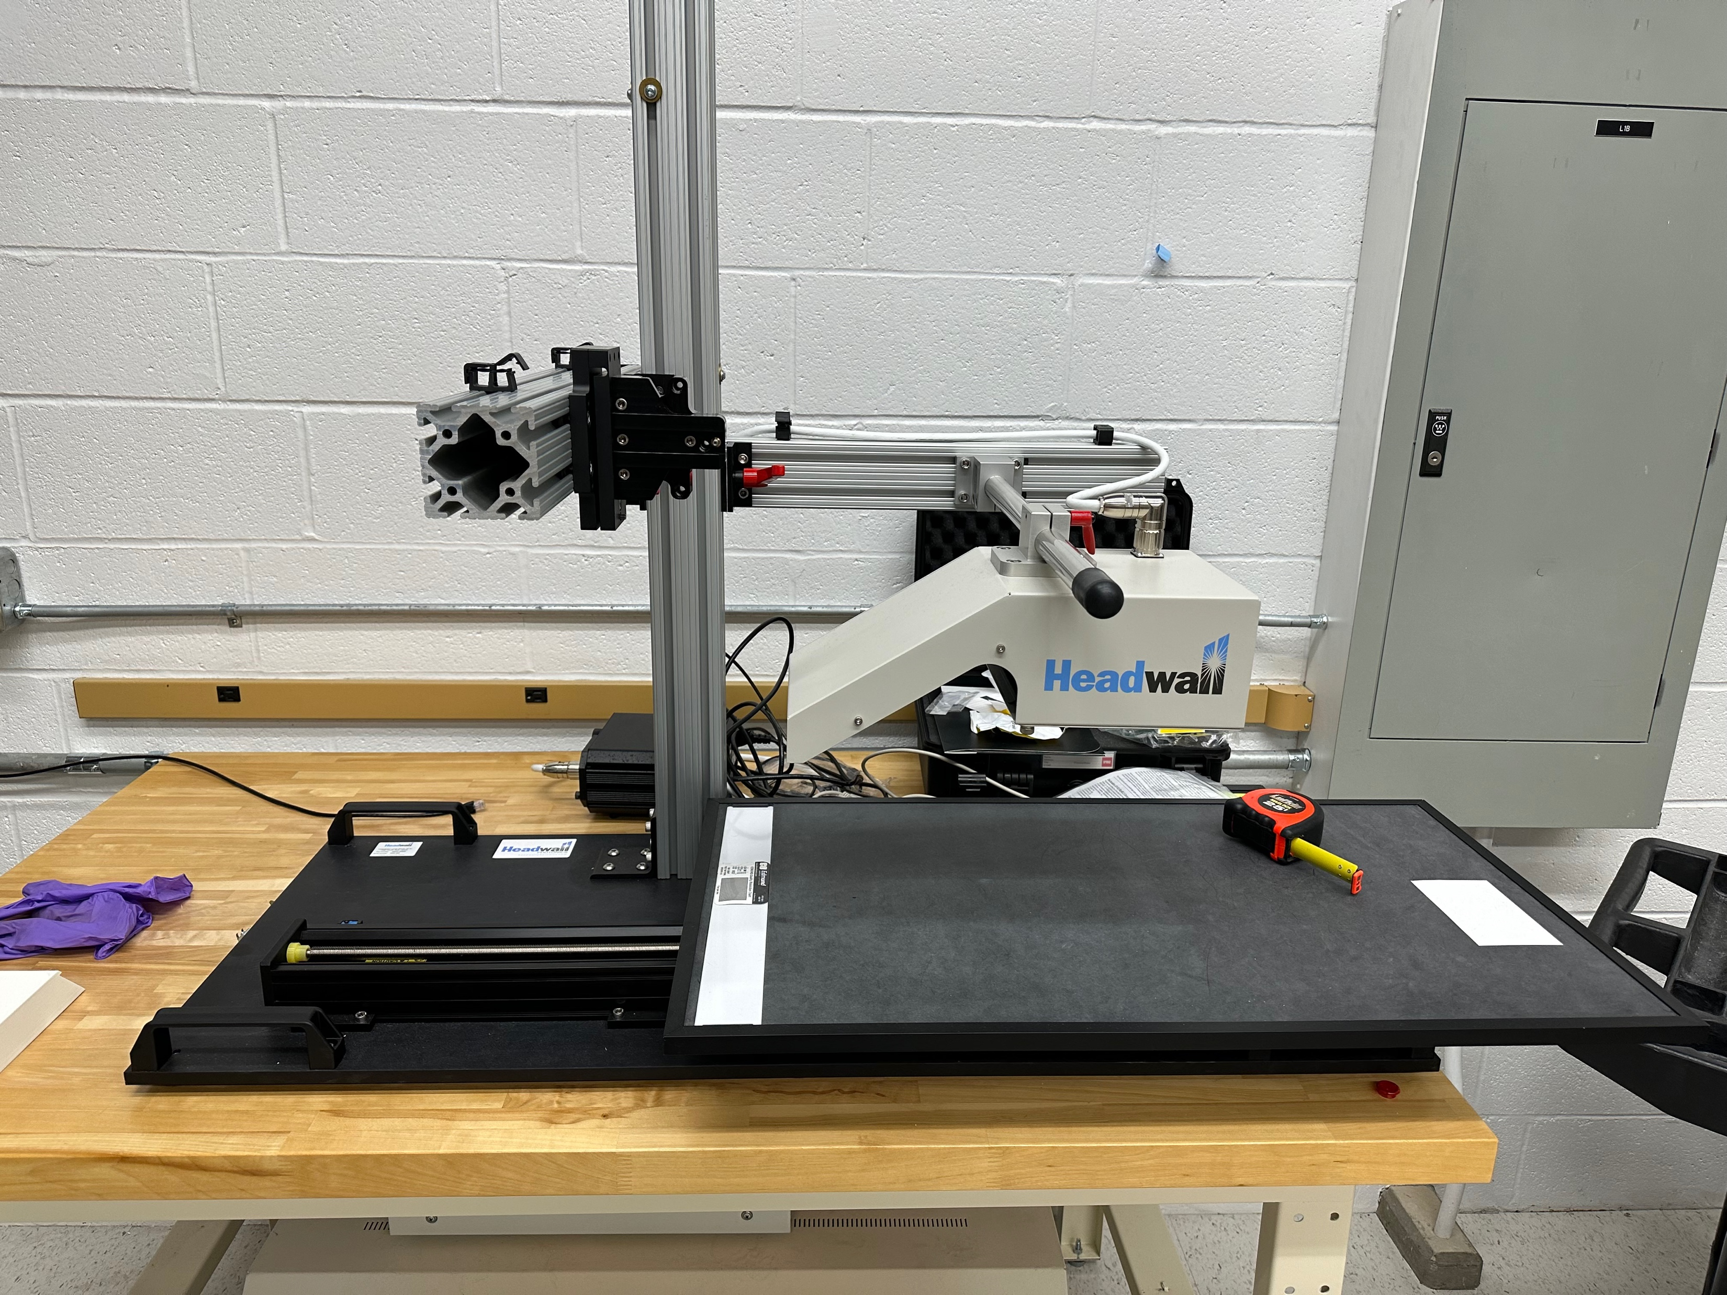

Slide 39
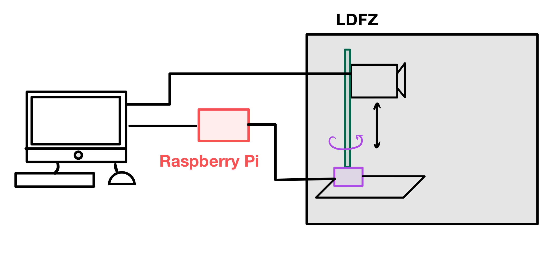
Notes:
How do we sync the motor with the image capture? We are replacing the stage with the motor

Slide 40
Extra Slides – Streaming

Slide 41
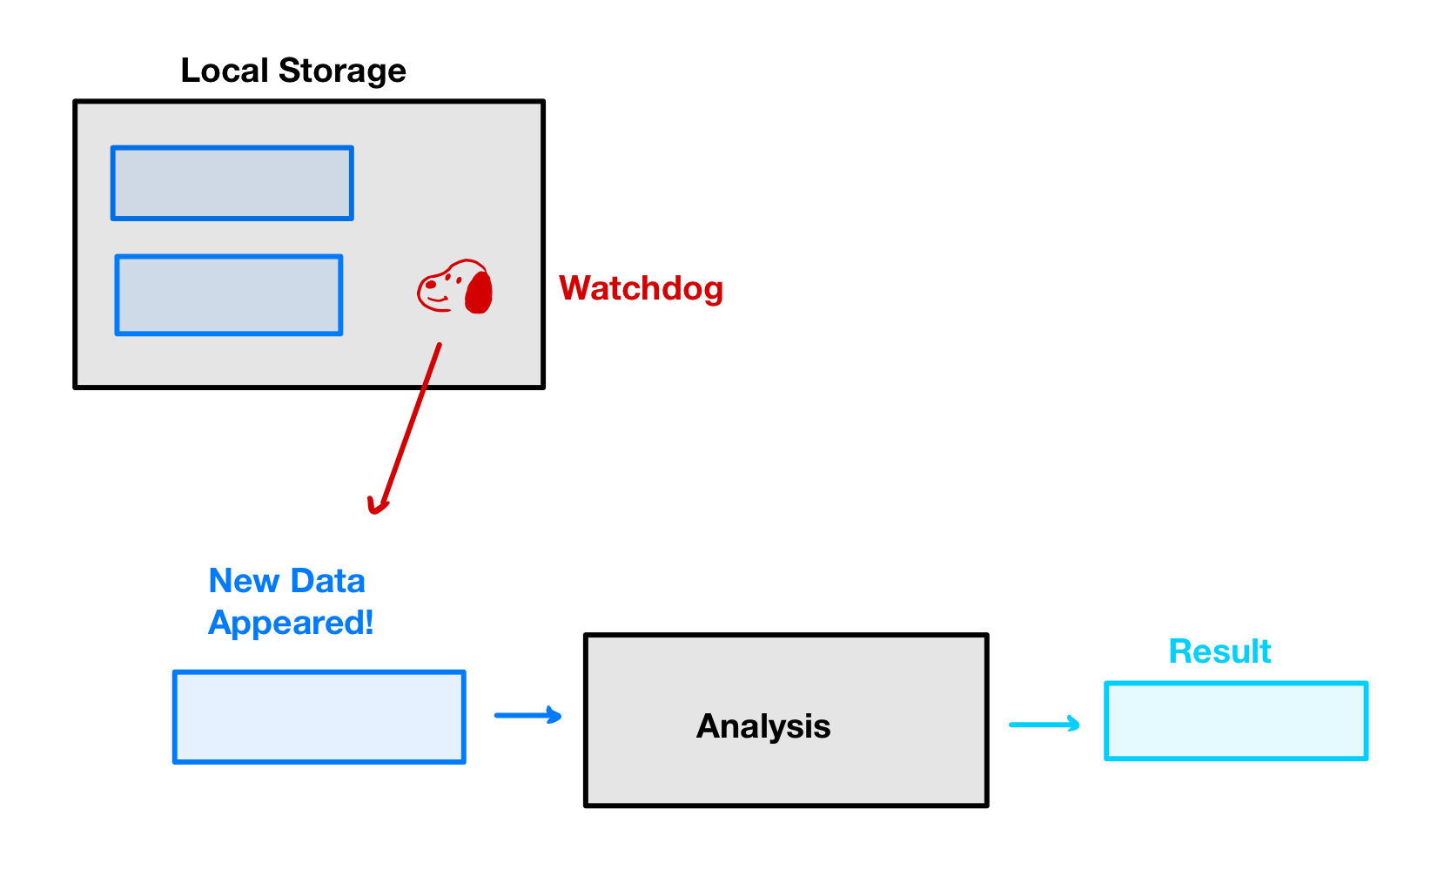

Slide 42
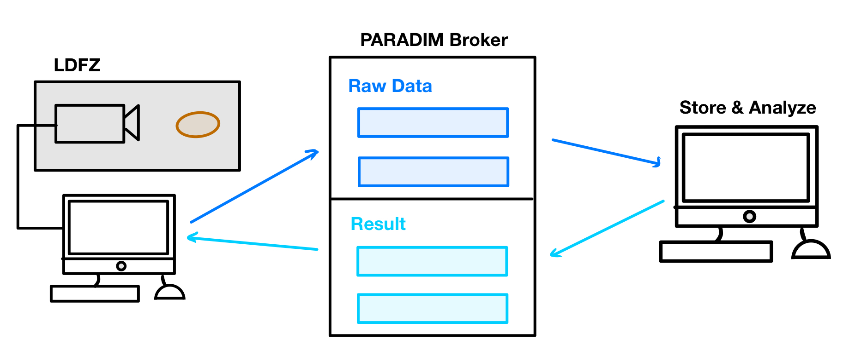
Notes:
Animate in one piece at a time

Slide 43
